Slide 1
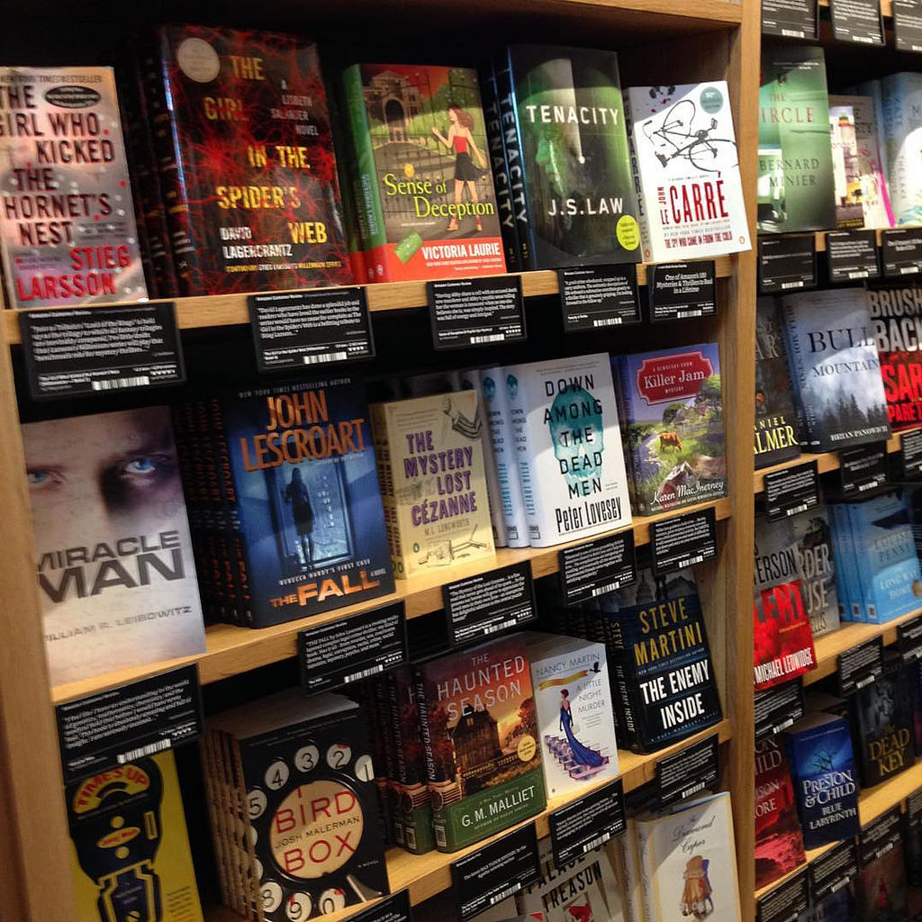
Publish Your Book!
In less than a week

